Slide 1
Rental Property Price Prediction in Warsaw
Igor Hebda s34836

Slide 2

1. Goal Definition
Create a machine learning model that predicts monthly rental prices for apartments in Warsaw based on property features and location.
Motivation:
The model will help tenants identify fair rental values, assist landlords in setting competitive prices, and provide real estate professionals with data-driven insights for the Warsaw rental market.

Slide 3
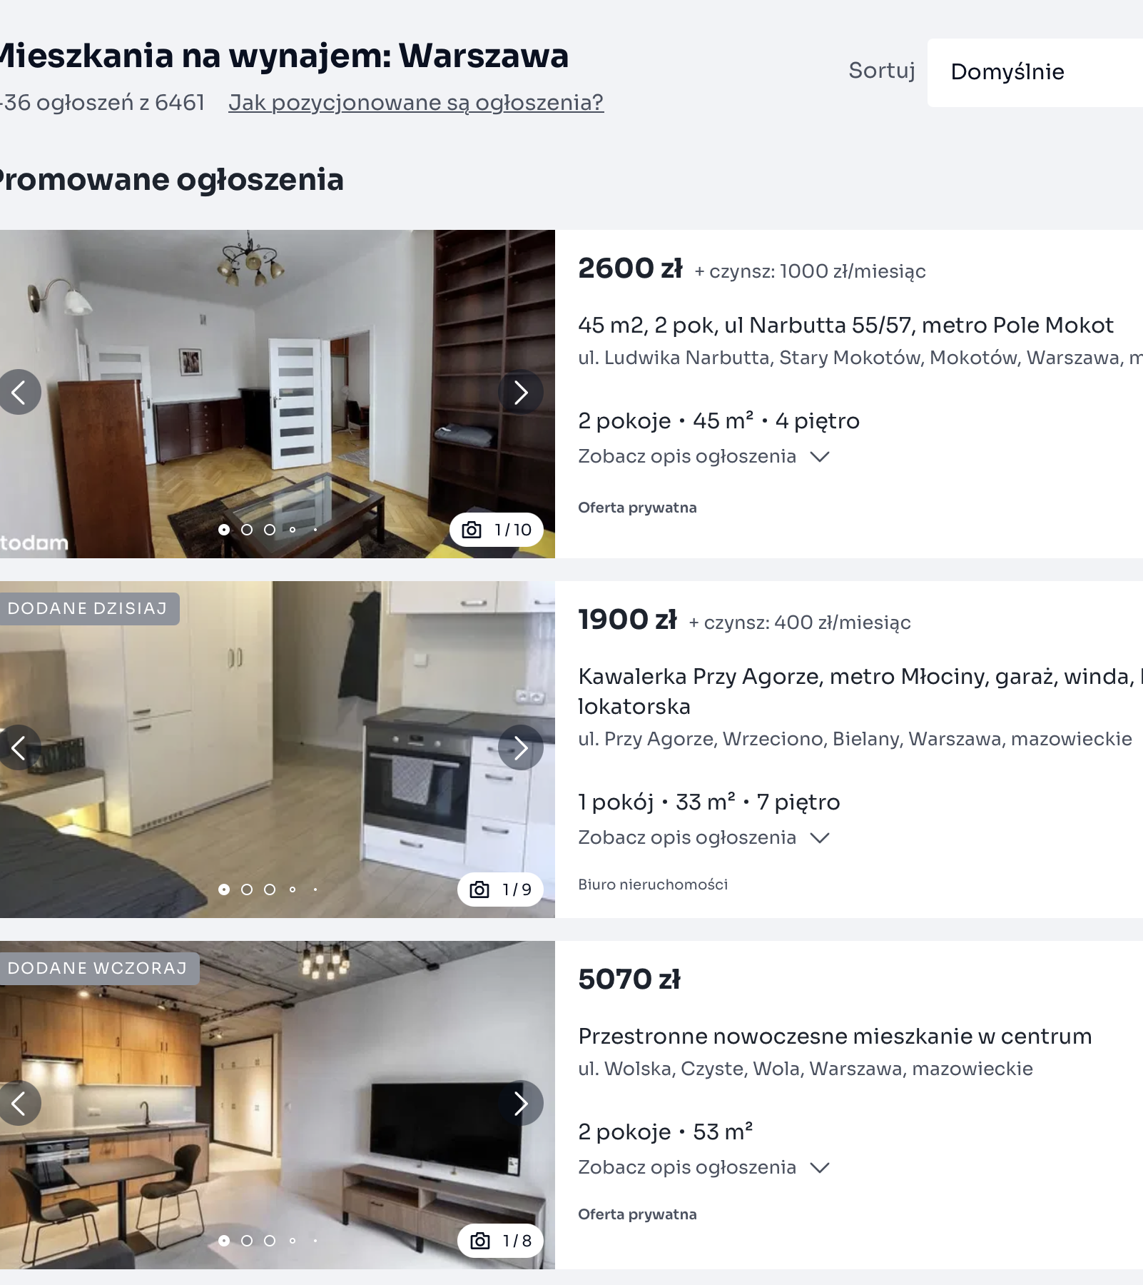
2. Data Collection
Stage 1: Source: otodom.pl
Aim: collect urls of property listings
Execution: script 2-1.py

Slide 4
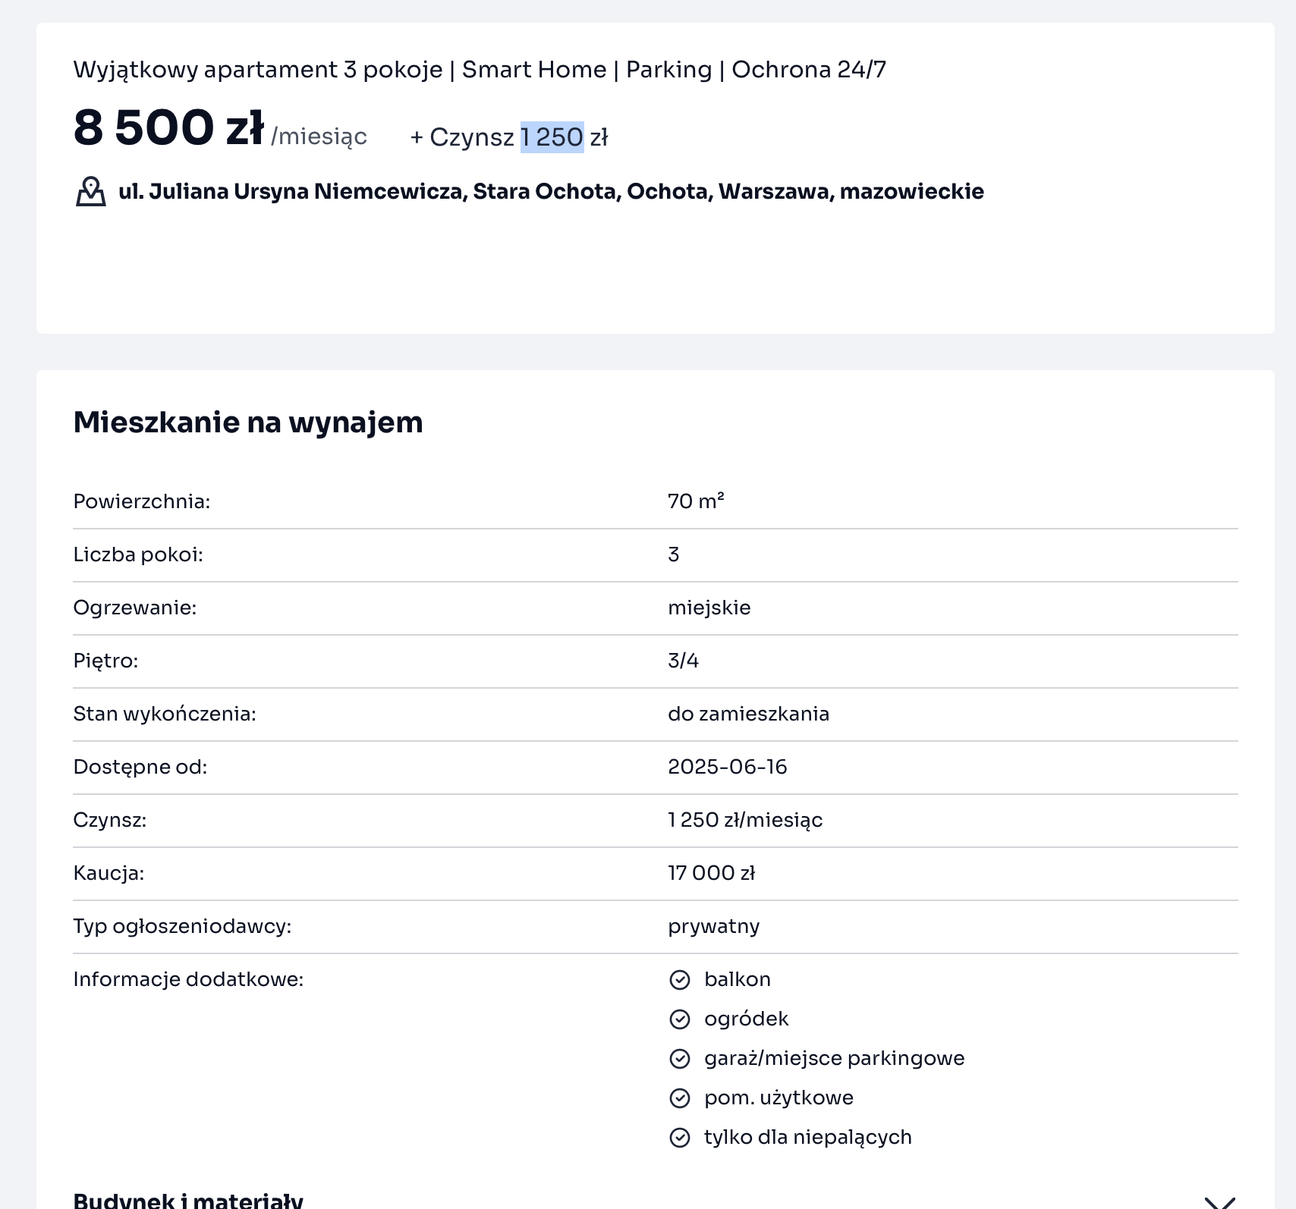
2. Data Collection
Stage 2: Source: otodom.pl
Aim: web scraping of property listings
Execution: script 2-2.py

Slide 5
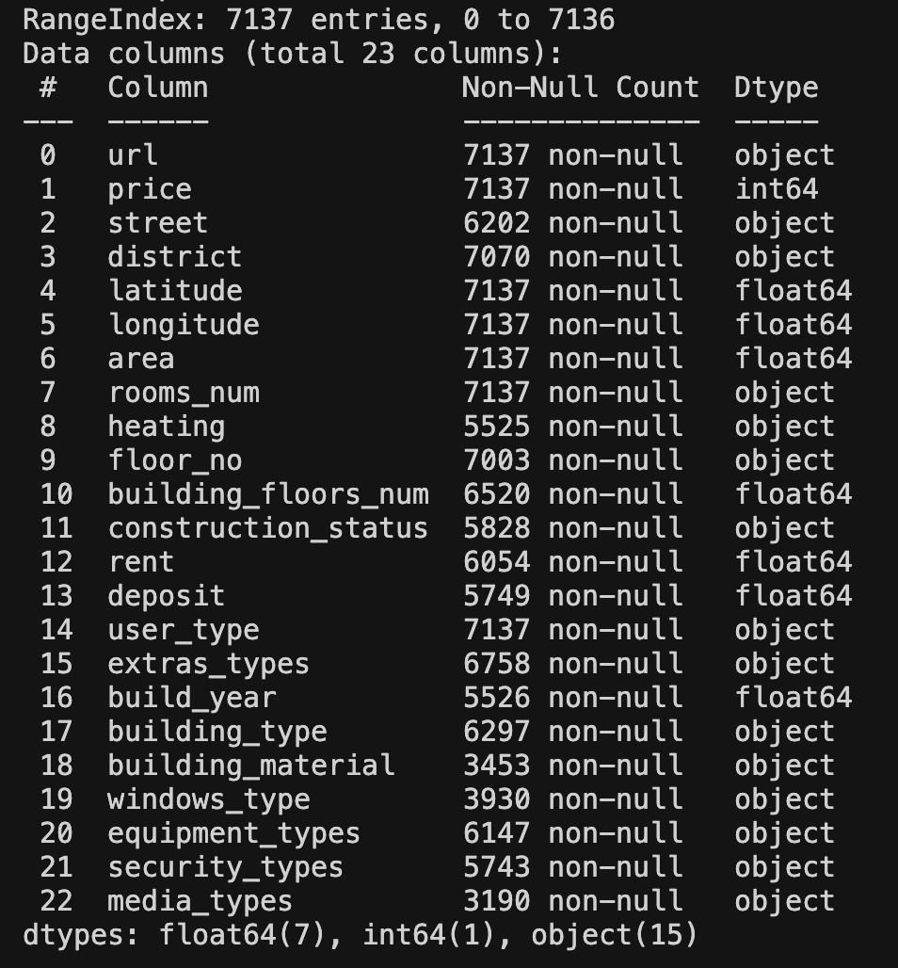
2. Data Collection
Stage 3: Source saved data
Aim: dataset (bronze layer)
Execution: script 2-3.py

Slide 6
2A. Data Pre Preprocessing
1. Drop duplicate urls
2. Total Price = Price + Rent
3. Drop listings with no price
4. Adding price per sqm
5. Creating dummies from list columns
6. Mapping districts
7. Dealing with rooms numer
8. Dealing with build year
9. Dealing with building floors numer
10. Dealing with building types

Slide 7
2A. Data Pre Preprocessing
11. Dealing with windows types
12. Dealing with user types
13. Dealing with heating
14. Dealing with construction status
15. Dealing with building material
16. Dealing with floors
17. Dealing with NaN in floor_numeric
18. Adding distance to center
19. Adding some additional columns
Execution: 2-4.py

Slide 8
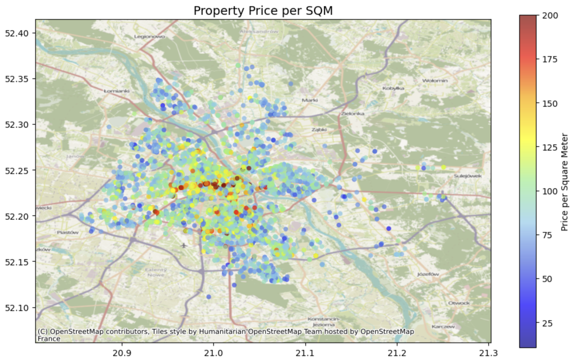
3. Exploratory Data Analysis/ 4. Data Preprocessing

Slide 9
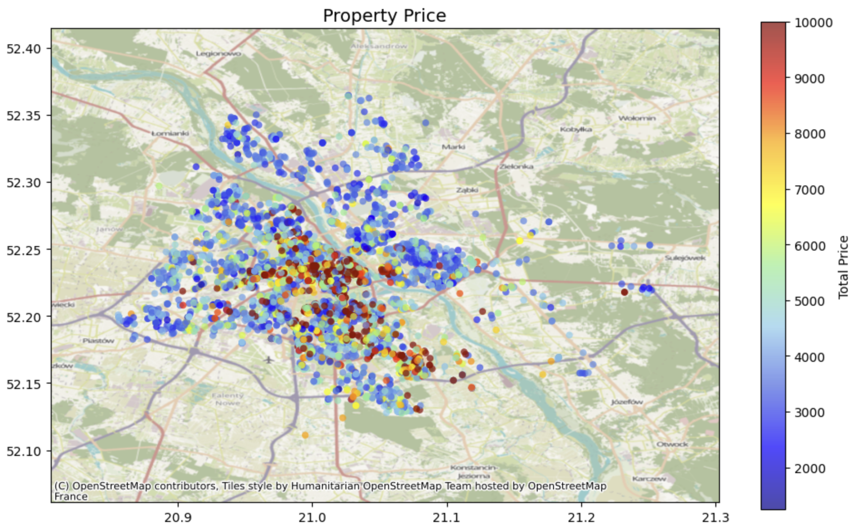

Slide 10
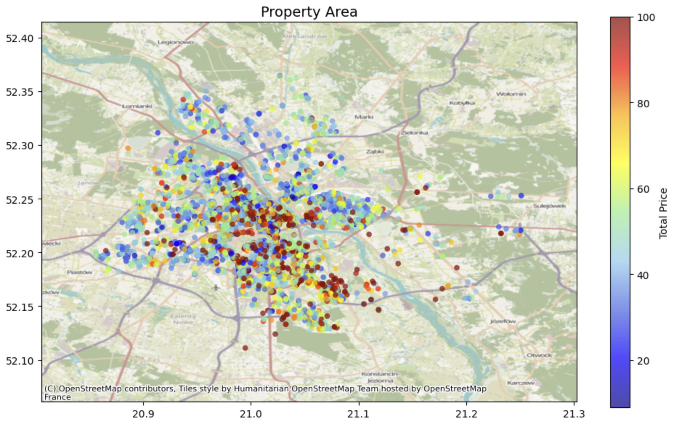

Slide 11
Very Rare Features (< 1%)
Column 0 count 1 count % of 1s
----------------------------------------------------------------------
district_Rembertów 5519 8 0.14%
heating_electrical 5518 9 0.16%
district_Wesoła 5516 11 0.20%
age_pre_1900 5511 16 0.29%
two_storey 5484 43 0.78%
district_Wawer 5483 44 0.80%
district_Unknown 5480 47 0.85%

Slide 12
Uncommon Features (1-5%)
Column 0 count 1 count % of 1s
----------------------------------------------------------------------
window_aluminium 5449 78 1.41%
floor_Special 5441 86 1.56%
district_Praga-Północ 5417 110 1.99%
district_Targówek 5411 116 2.10%
district_Ursus 5395 132 2.39%
size_Huge 5386 141 2.55%
district_Żoliborz 5382 145 2.62%
district_Włochy 5381 146 2.64%
material_concrete 5378 149 2.70%
many_rooms 5377 150 2.71%
district_Bielany 5365 162 2.93%

Slide 13
Uncommon Features (1-5%) (cont.)
Column 0 count 1 count % of 1s
----------------------------------------------------------------------
heating_gas_heating 5354 173 3.13%
district_Bemowo 5349 178 3.22%
district_Białołęka 5329 198 3.58%
district_Ochota 5327 200 3.62%
material_concrete_plate 5325 202 3.65%
district_Ursynów 5307 220 3.98%
roller_shutters 5301 226 4.09%
age_1980_1999 5297 230 4.16%
district_Other 5278 249 4.51%
height_low_rise 5262 265 4.79%
age_1900_1949 5259 268 4.85%
district_Wilanów 5254 273 4.94%

Slide 14
Features analysis
There is heating_Other 22.71, heating_electrical 0.16% , heating_gas_heating 3.13% and heating_urban 74.00%. Lets combine heating_Other, heating_electrical, heating_gas_heating into heating_combined_other.
There is age_pre_1900 0.29%. Lets combine it with age_1900_1949.
Column two_storey is 0.78%. Lets drop it.
We have: district_Rembertów 0.14%, district_Wesoła 0.20%, district_Wawer 0.80%, district_Unknown 0.85%. Lets combine it to district_other.
We have window_aluminium 1.41%. Lets combine it with window_other.

Slide 15
Outcome of Features analysis
Column 0 count 1 count % of 1s
----------------------------------------------------------------------
floor_Special 5441 86 1.56%
district_Praga-Północ 5417 110 1.99%
district_other 5417 110 1.99%
district_Targówek 5411 116 2.10%
district_Ursus 5395 132 2.39%
size_Huge 5386 141 2.55%
district_Żoliborz 5382 145 2.62%
district_Włochy 5381 146 2.64%
material_concrete 5378 149 2.70%
many_rooms 5377 150 2.71%
…

Slide 16
Correlation analysis
construction_ready_to_use construction_Other 1.000000
heating_combined_other heating_urban 1.000000
user_type_private_owner user_type_agency 1.000000
material_brick material_Other 0.862328
price_per_room price_per_sqm 0.830368
rooms_num area 0.821654
oven fridge 0.816529
washing_machine fridge 0.806308
amenities_score oven 0.786751
floor_numeric floor_VeryHigh 0.785706
price_per_room total_price 0.770090
window_plastic window_Other 0.766108
…

Slide 17
Correlation analysis
Dropping redundant columns ['construction_Other', 'heating_combined_other', 'user_type_private_owner', 'material_Other']

Slide 18
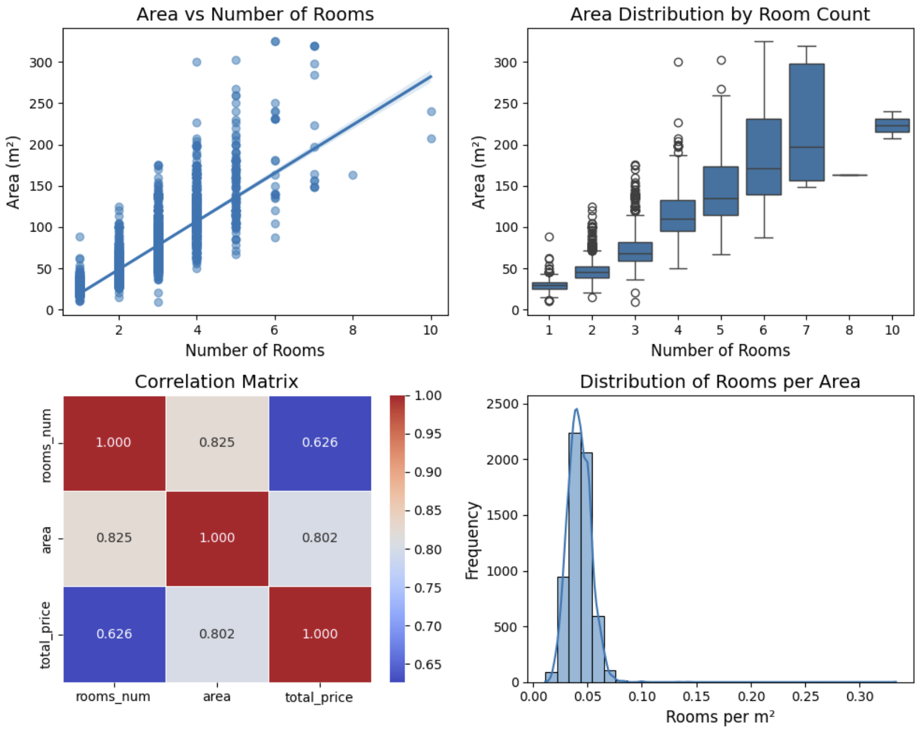

Slide 19
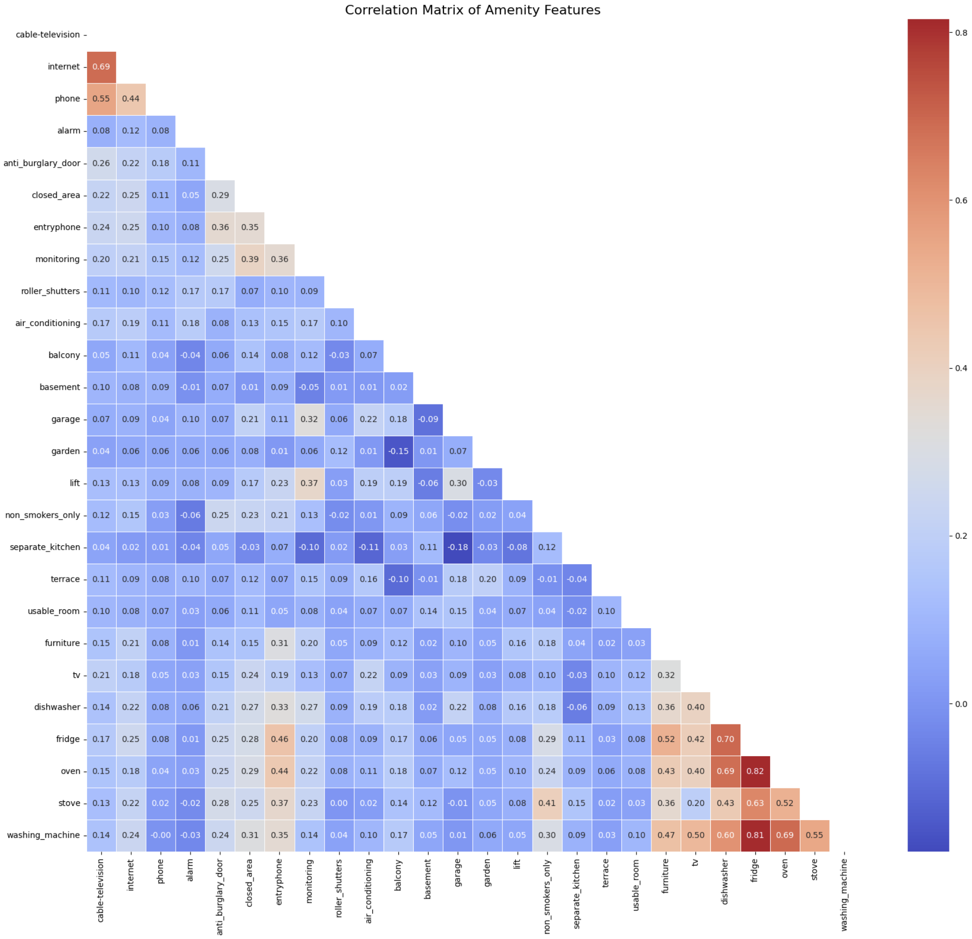

Slide 20
Amenity groupings based on correlation patterns
kitchen_furniture_amenities : washing_machine, oven, fridge, dishwasher, tv, furniture, stove
security_amenities : anti_burglary_door, closed_area, entryphone, monitoring, non_smokers_only
tech_amenities : cable-television, phone, internet
premium_amenities : garden, terrace, air_conditioning, roller_shutters, alarm
infrastructure_amenities : lift, balcony, garage
interior_amenities : separate_kitchen, usable_room, basement

Slide 21
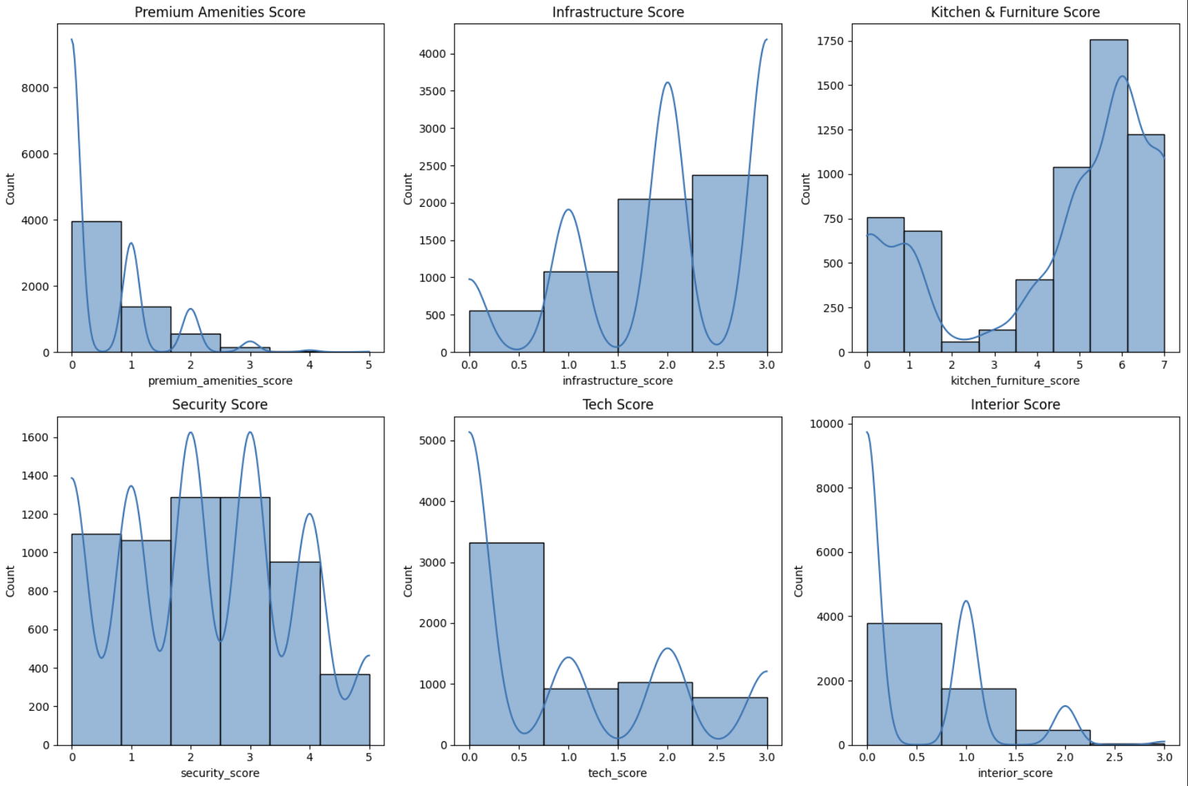

Slide 22
Price outliers
Outlier thresholds (1.5 IQR method):
Lower bound: -846.88
Upper bound: 11388.12
Number of outliers: 595 (9.83% of the data)
Outlier range: 1250.00 to -846.88 and 11388.12 to 57000.00
The data is right-skewed (many more high prices than low prices). The IQR method assumes a symmetric distribution. When applied to skewed data, it can produce impossible thresholds.

Slide 23
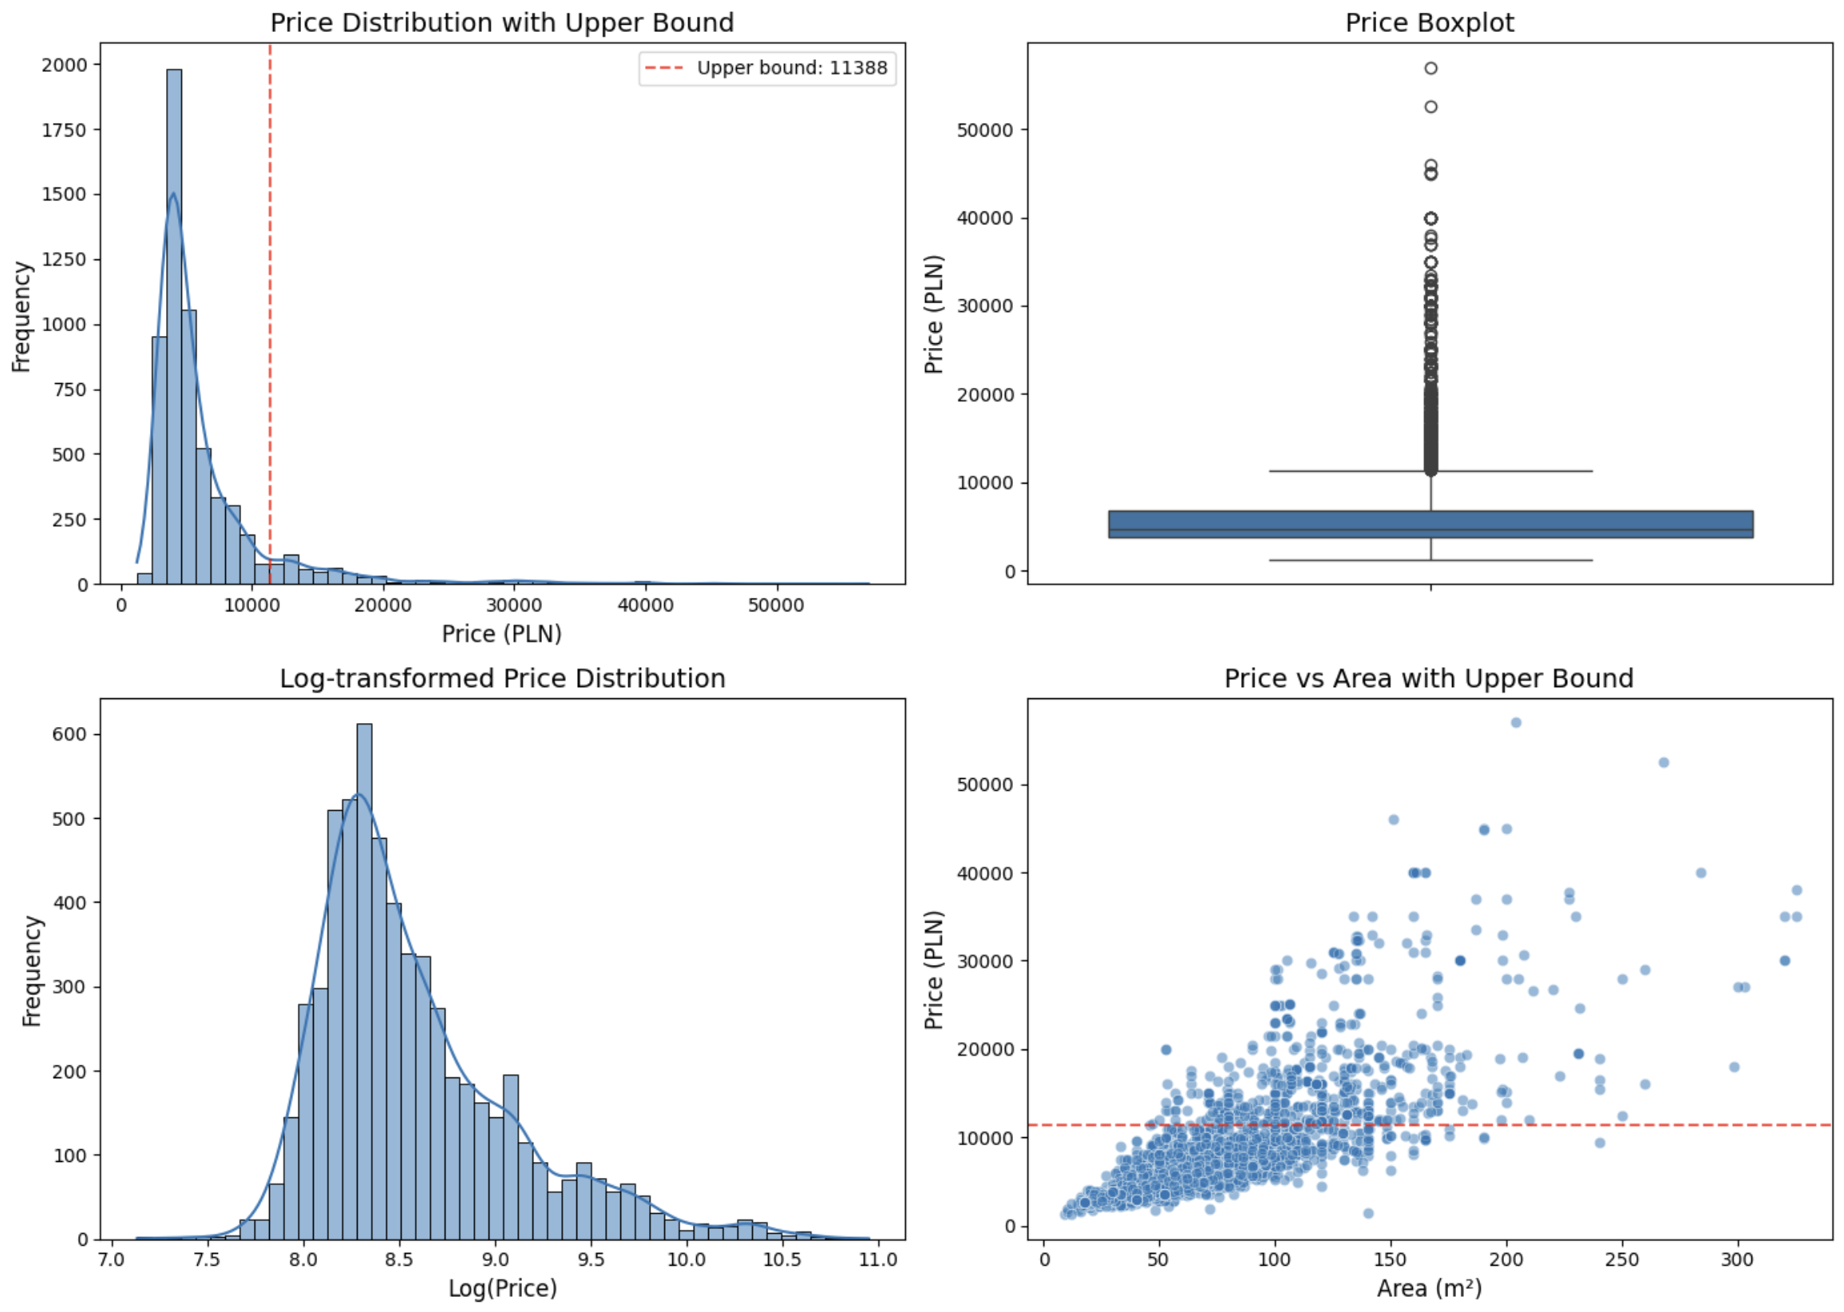
Outliers are not errors. Decision: log(price)

Slide 24
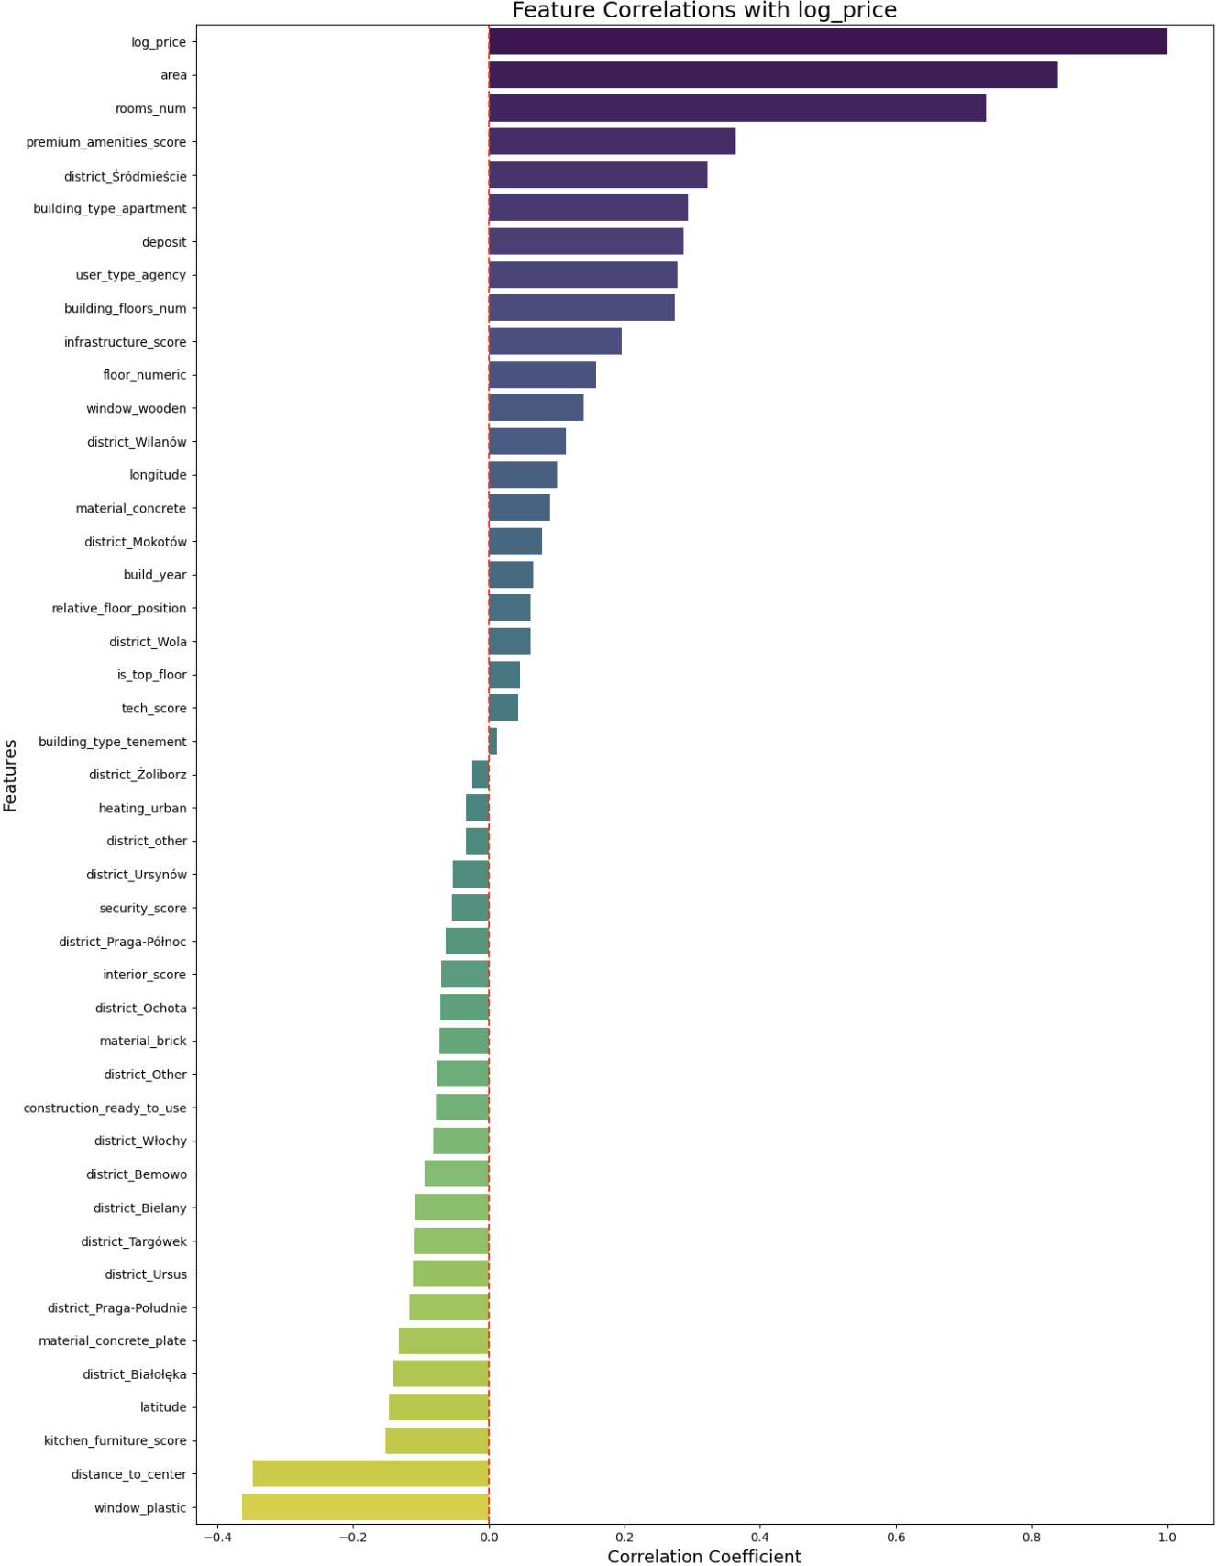
Feature correlations with log price

Slide 25
Feature correlations with log price (cont.)

Slide 26
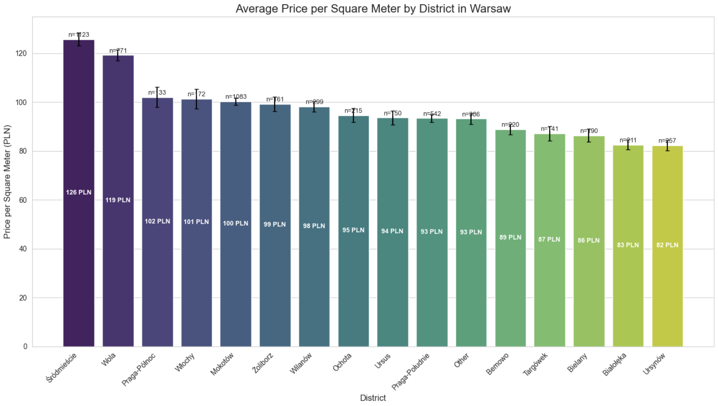

Slide 27
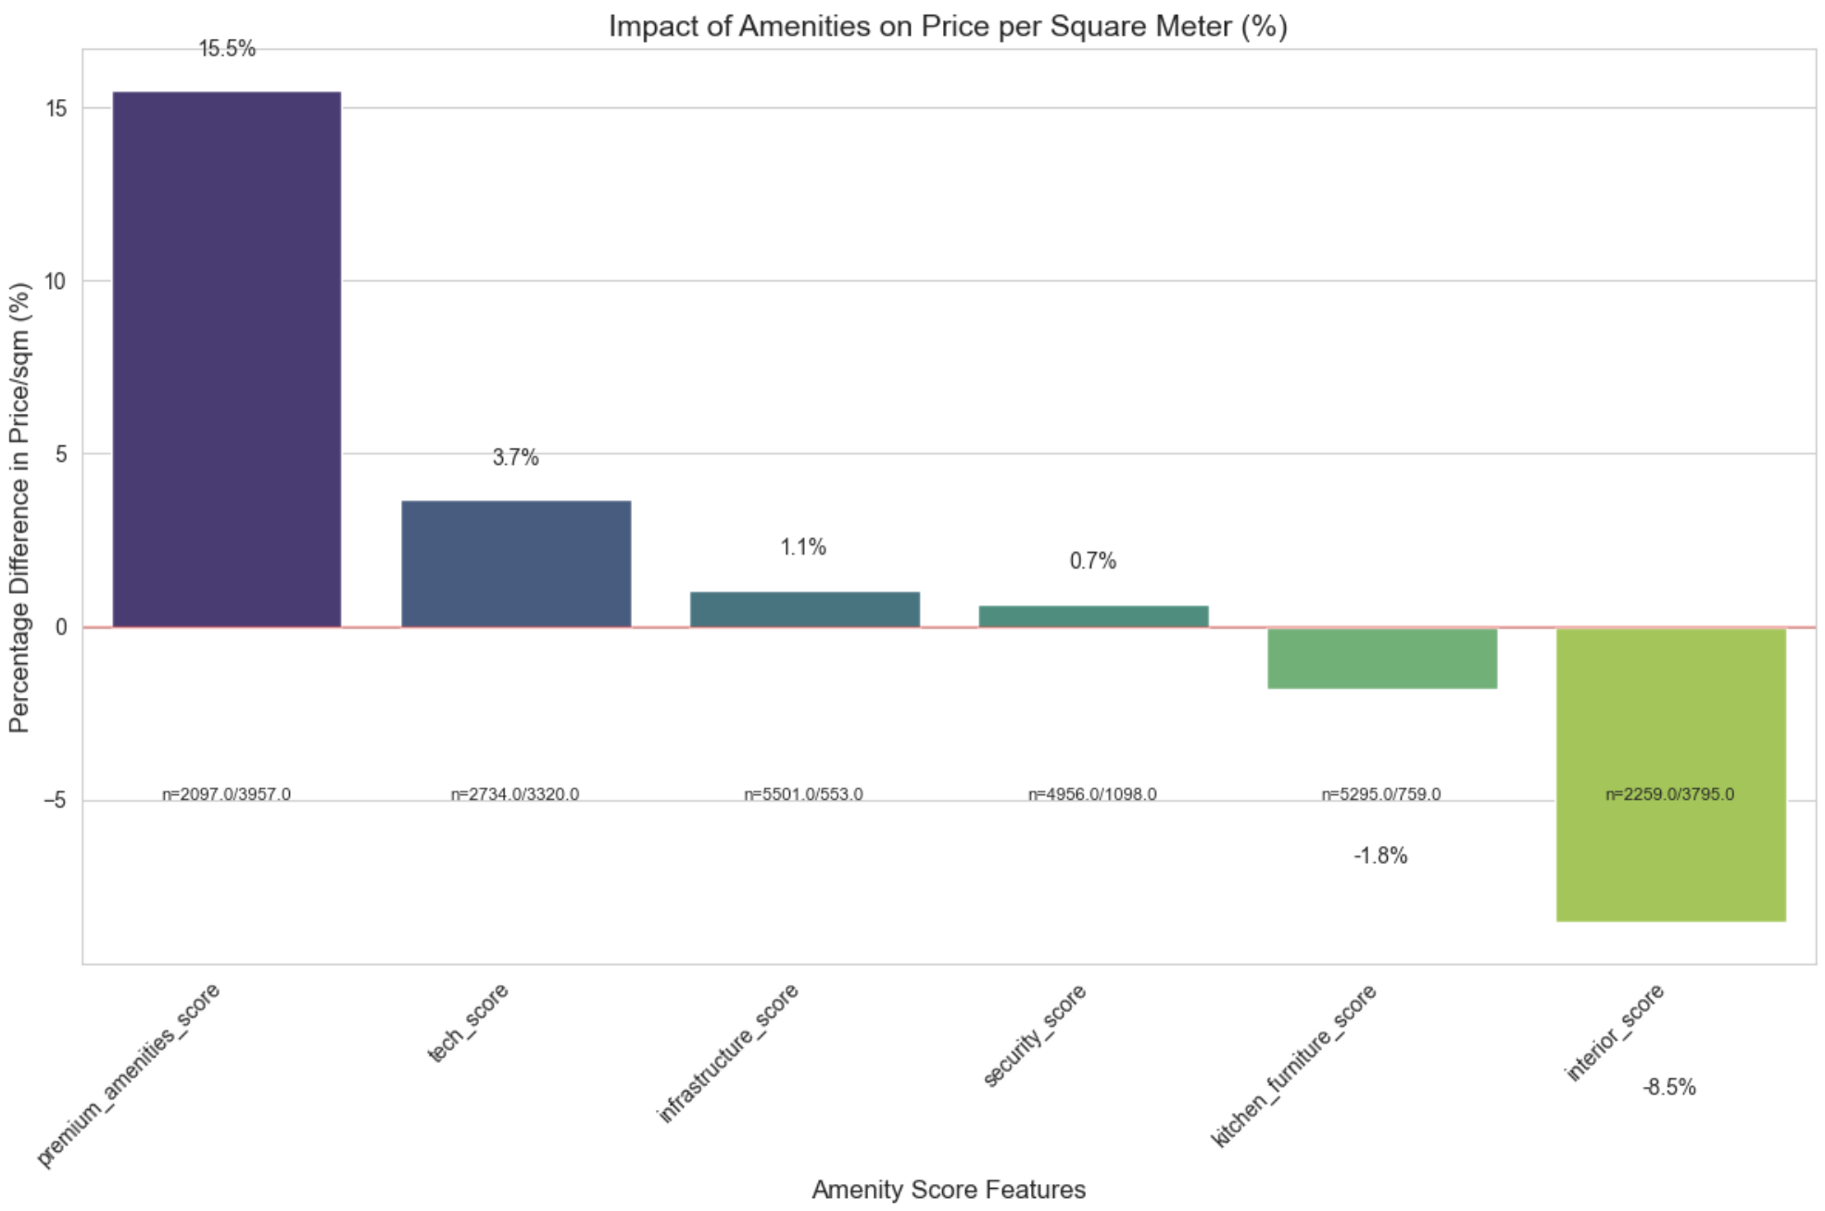

Slide 28
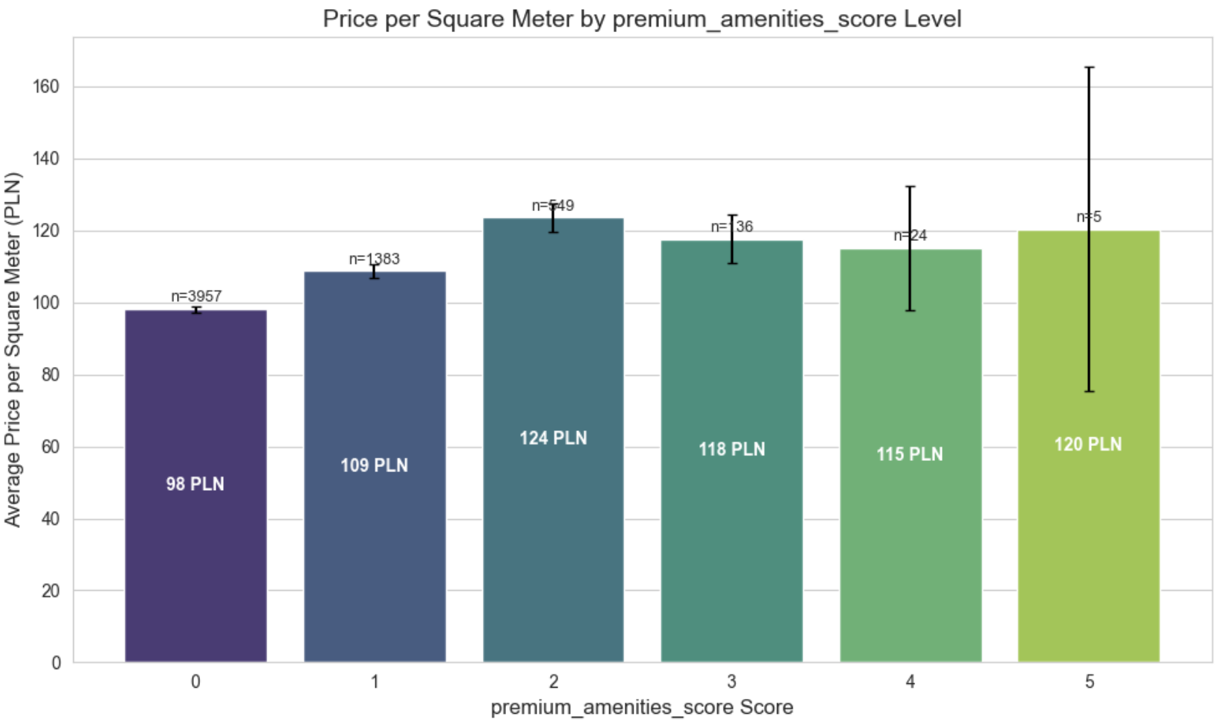

Slide 29
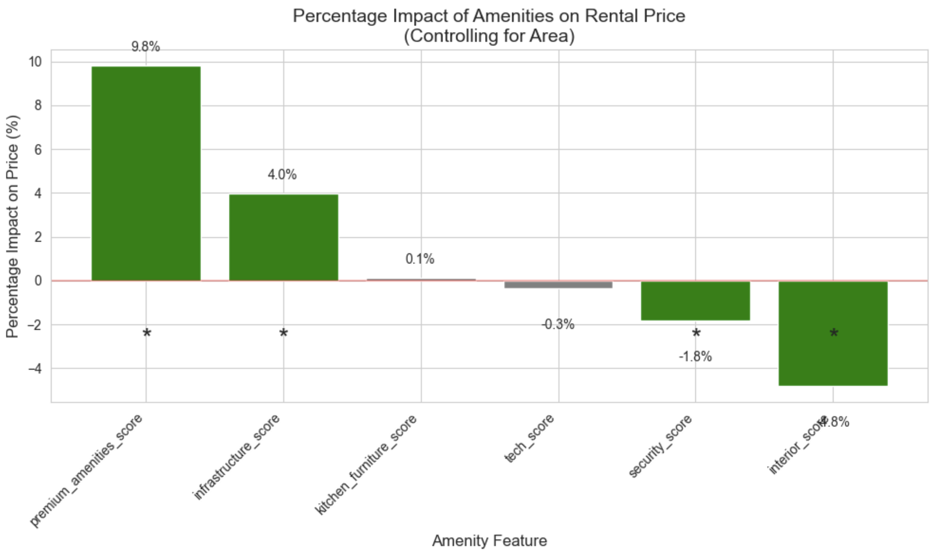

Slide 30
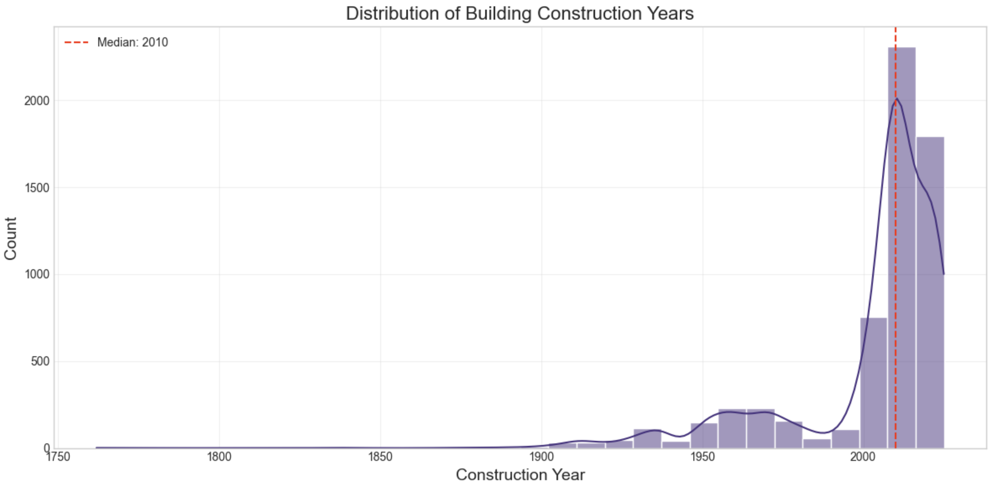

Slide 31
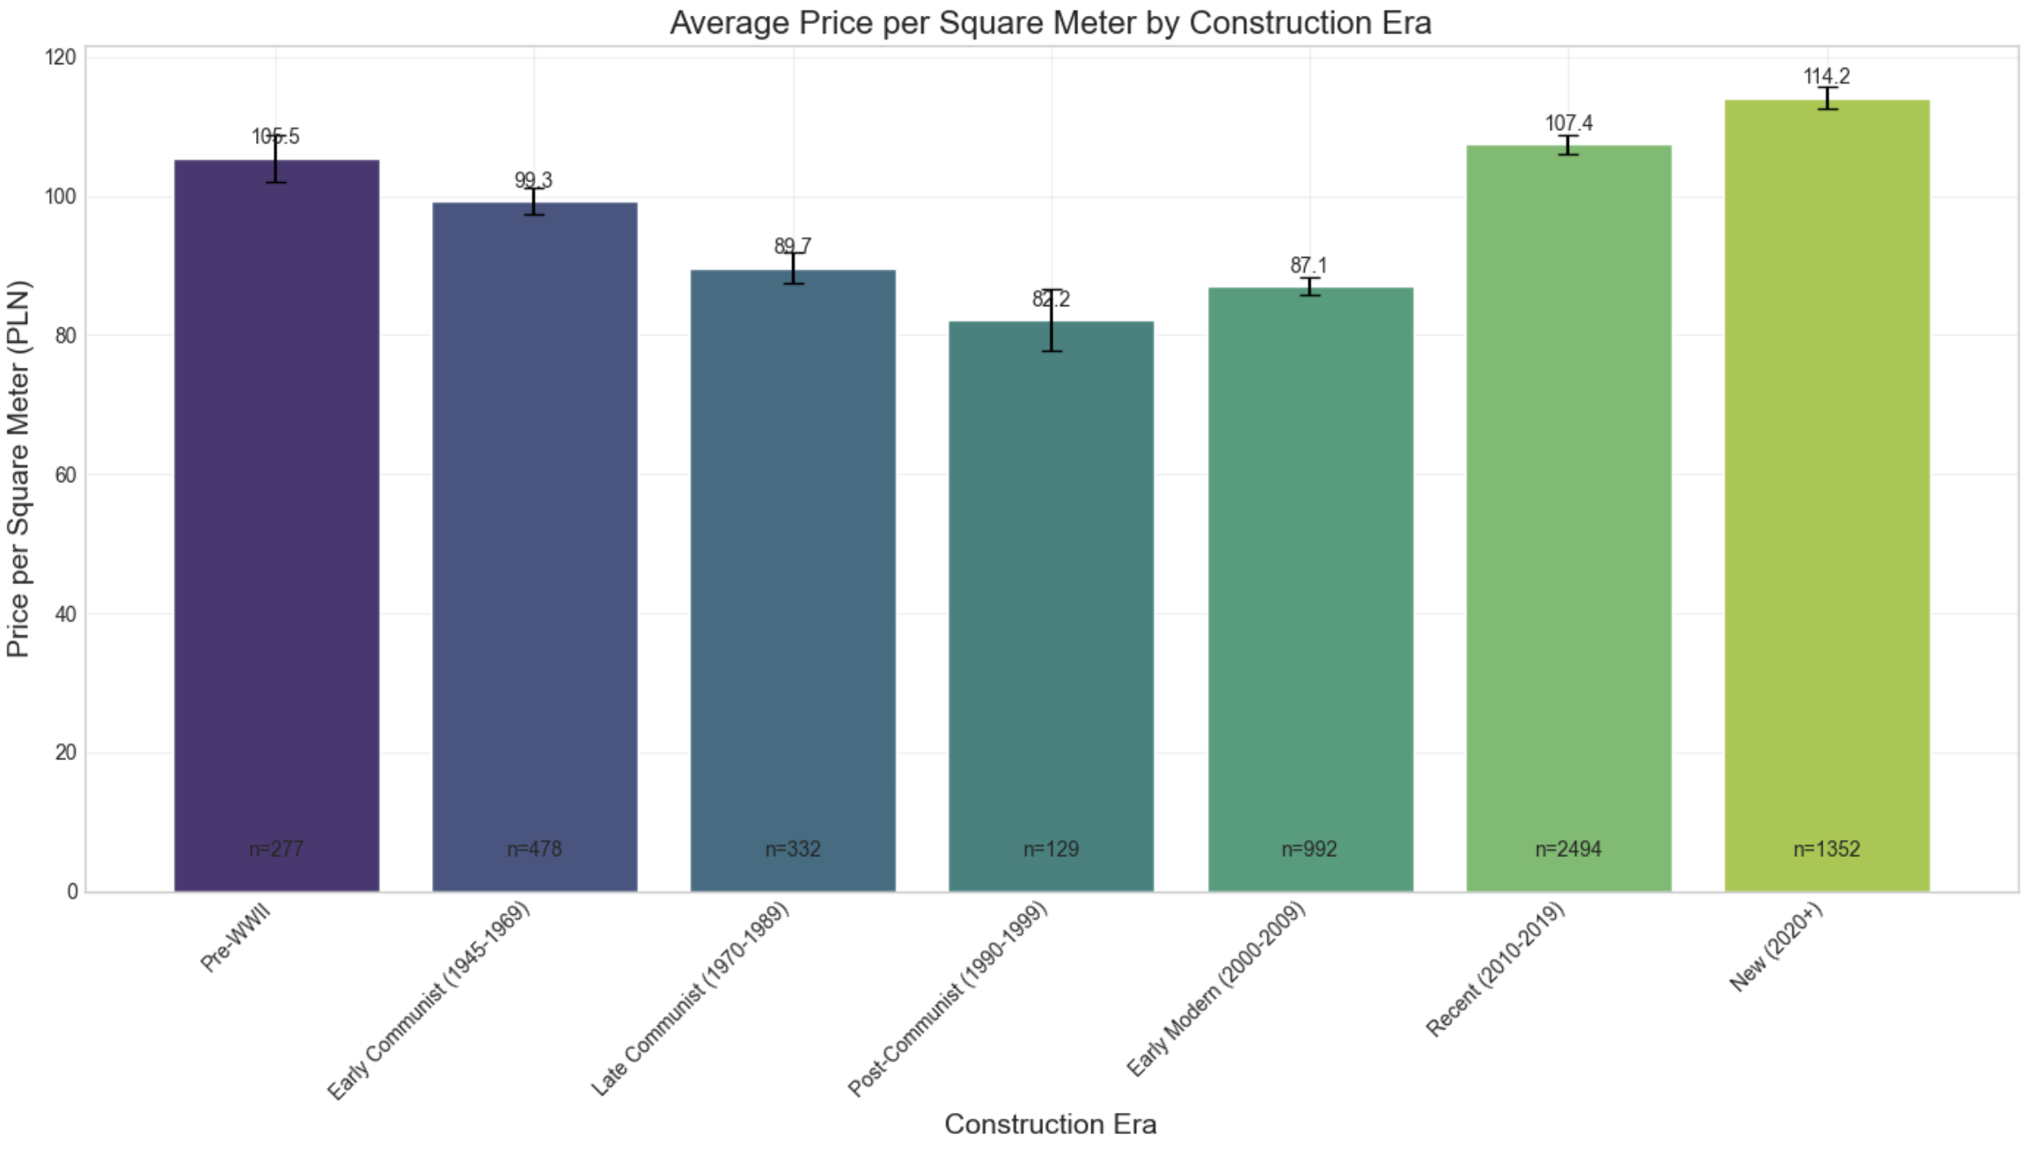

Slide 32
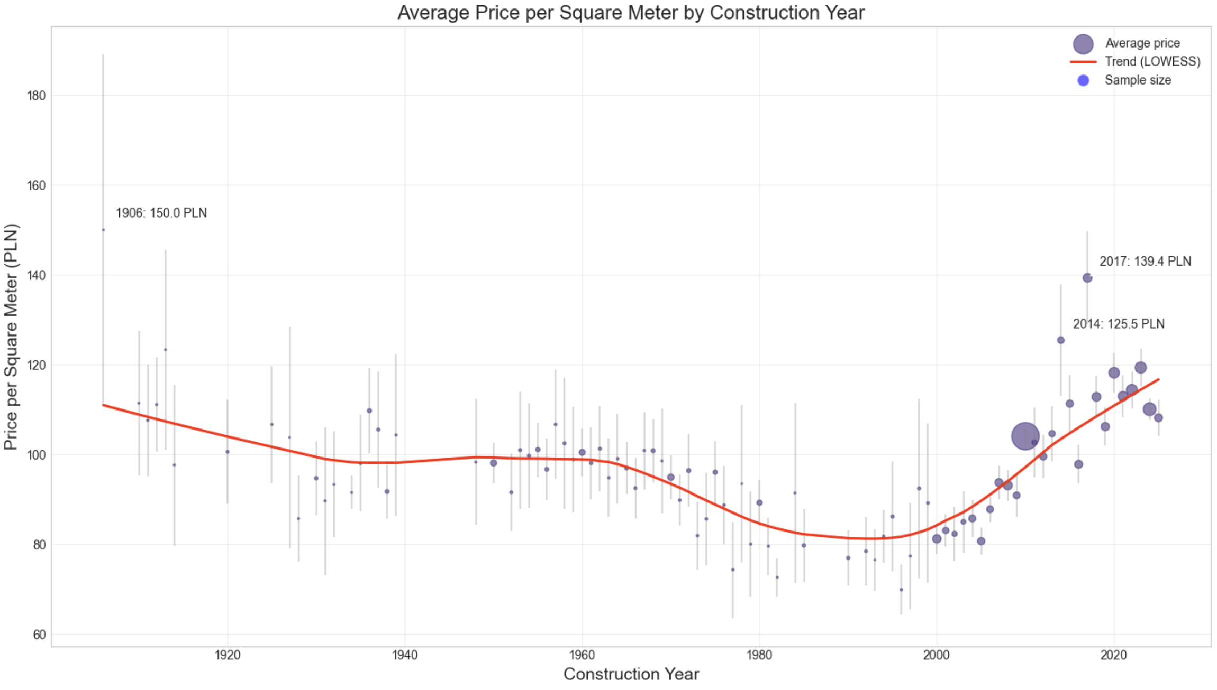

Slide 33
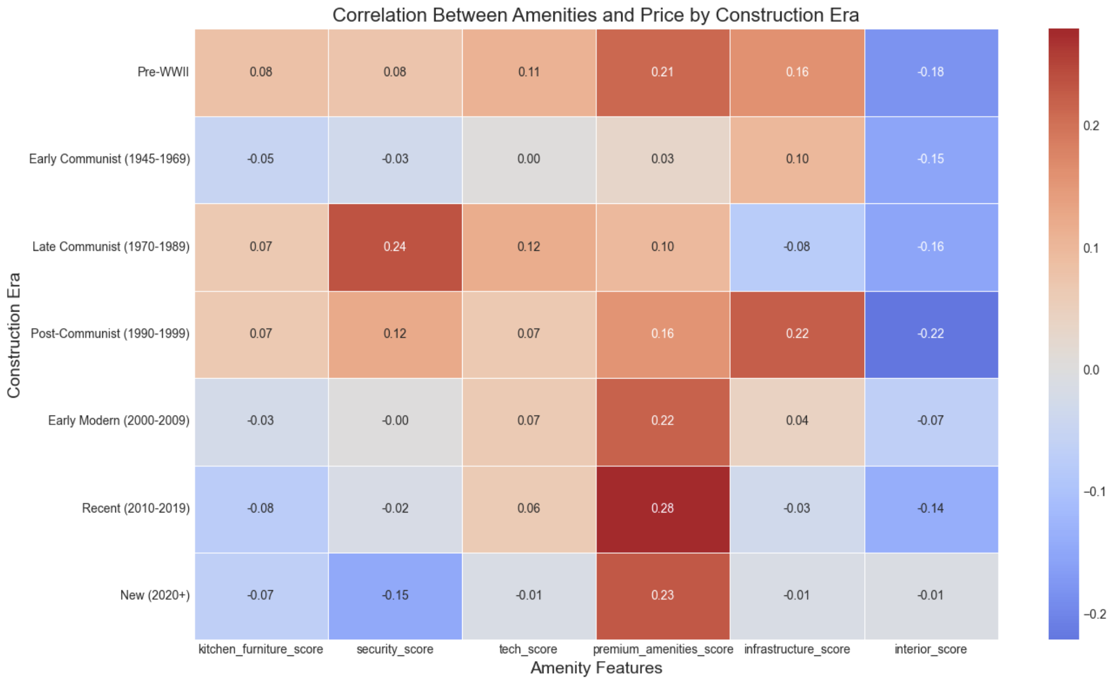

Slide 34
Standarization z-score
z-score normalization variables:
area,
distance_to_center,
building_floors_num,
floor_numeric,
build_year,
relative_floor_position
Execution of section 3 and 4: 3-1.py and 3-2.py

Slide 35
5. Modeling & 6. Evaluation

Slide 36
Data splitting
Training set: 3632 samples (60.0%)
Validation set: 1211 samples (20.0%)
Test set: 1211 samples (20.0%)

Slide 37
Model Validation Results (on val ds)
RMSE MAE R² MAPE (%)
RandomForest 0.160118 0.110502 0.911652 11.214817
GradientBoosting 0.165783 0.119077 0.905289 11.967432
Ridge Regression 0.213093 0.152403 0.843521 15.613161
Linear Regression 0.213121 0.152426 0.843480 15.616803
ElasticNet 0.219497 0.156776 0.833974 15.961486
Lasso Regression 0.225583 0.161120 0.824639 16.368265
Best model: RandomForest

Slide 38
Best model (RandomForest) performance on test set
RMSE: 0.1526
MAE: 0.1056
R²: 0.9121
MAPE (%): 10.6270
feature | importance
area | 0.748372
distance_to_center | 0.077801
building_floors_num | 0.035271
build_year | 0.033822
rooms_num | 0.018389
premium_amenities_score | 0.008917
relative_floor_position | 0.008365
floor_numeric | 0.007171
kitchen_furniture_score | 0.006620
infrastructure_score | 0.006430

Slide 39
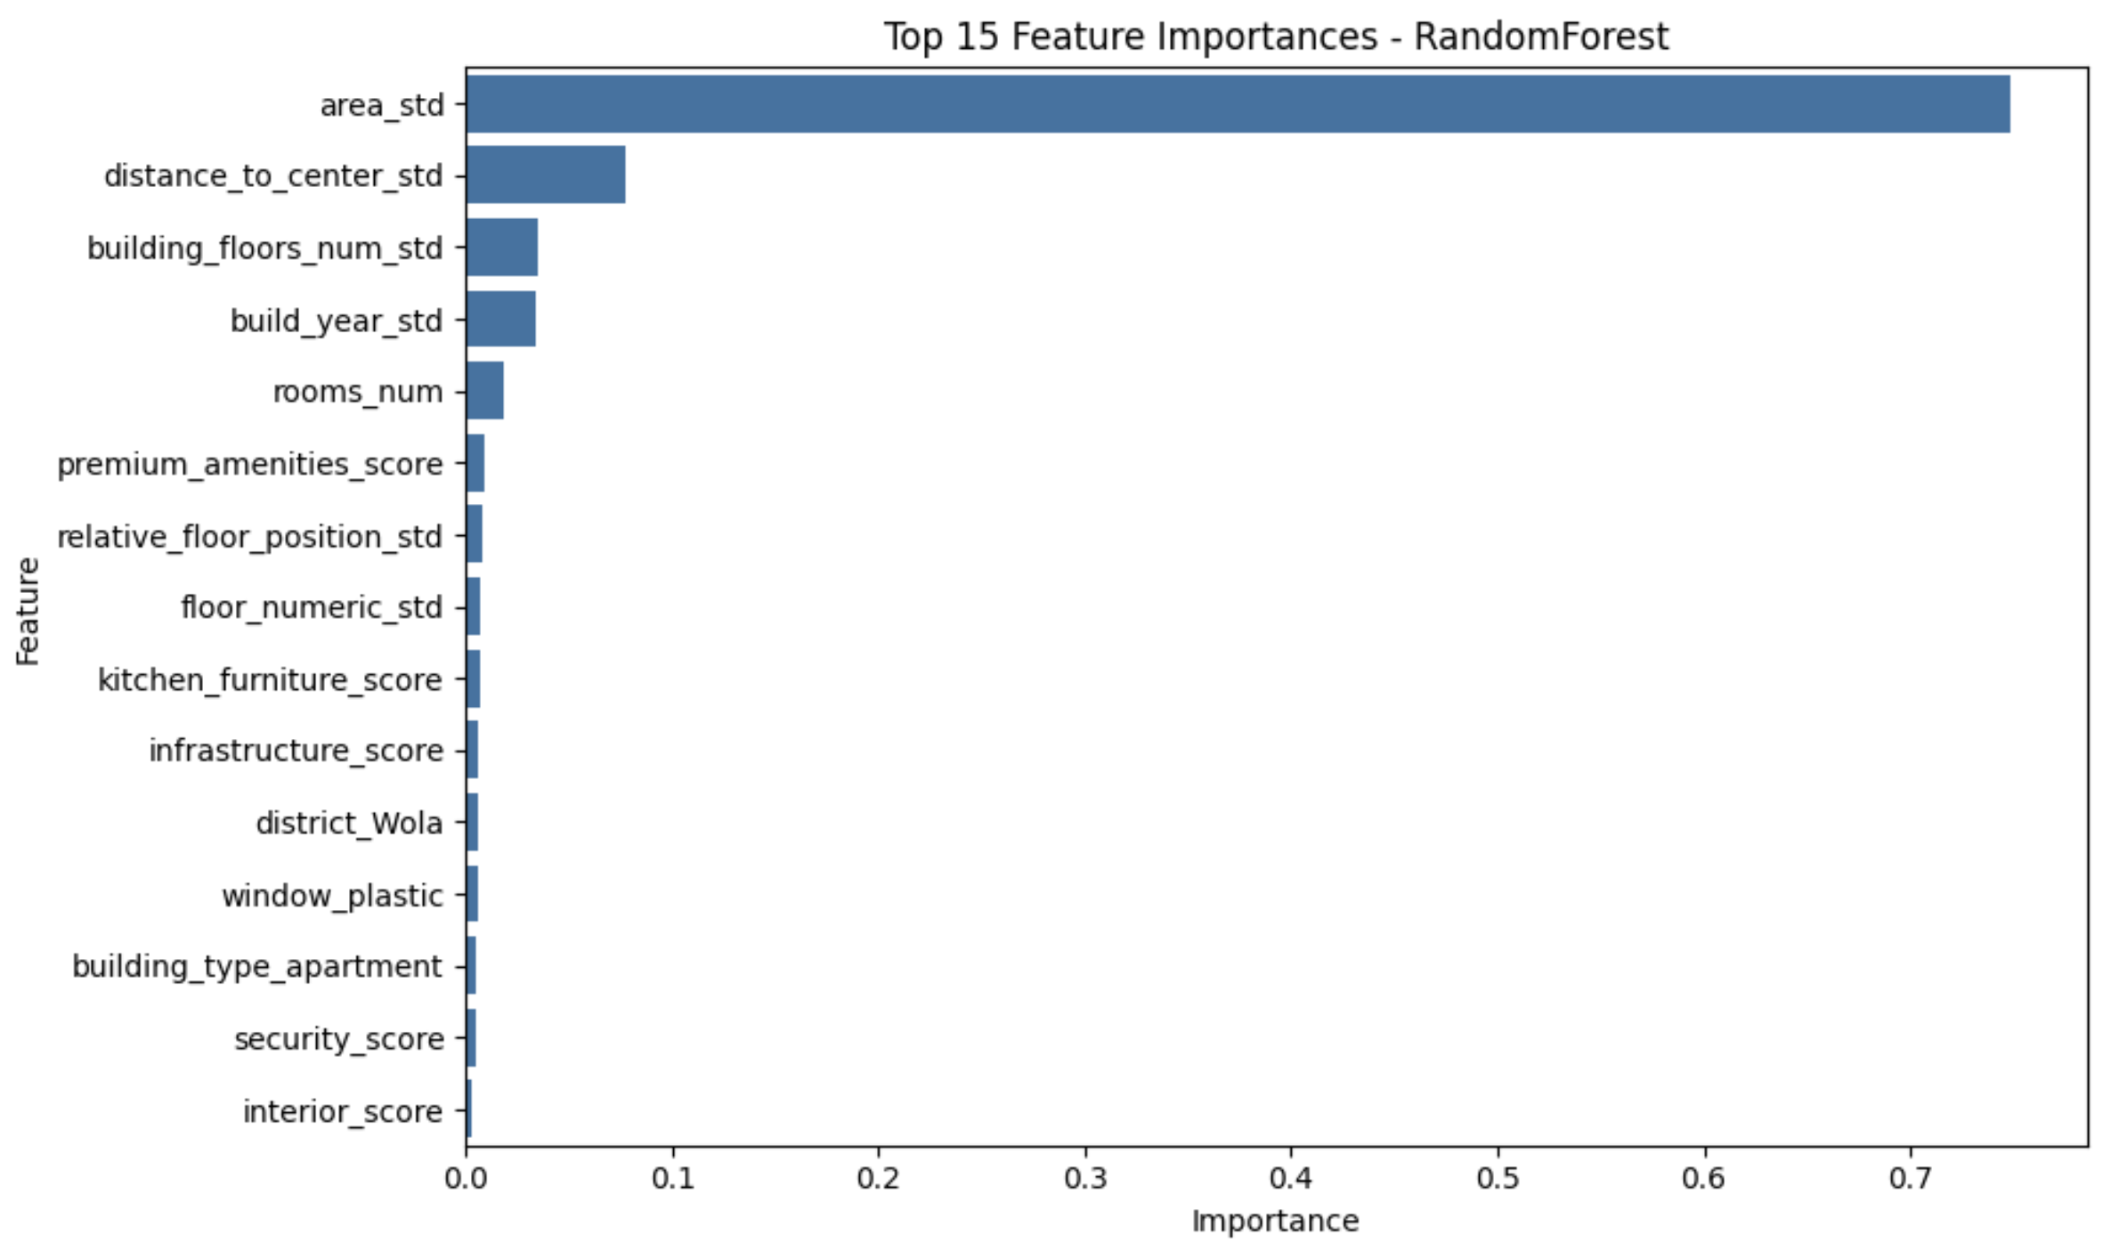

Slide 40
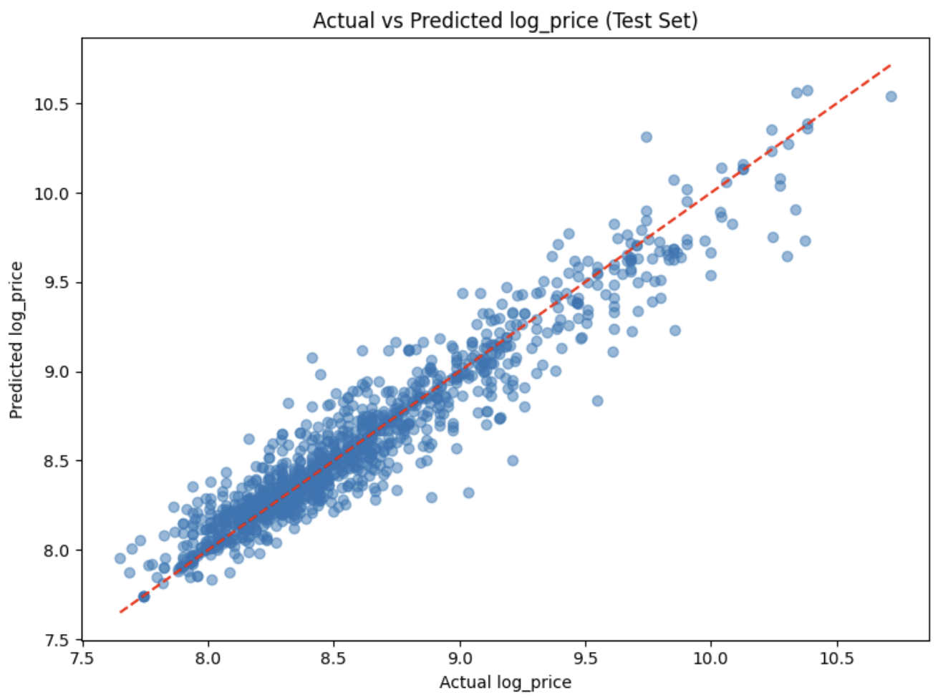

Slide 41
Feature engineering
Approach:
Added 13 new engineered features to enhance our Random Forest model
Original dataset: 41 features → Enhanced dataset: 54 features
Engineered features capture complex relationships between property attributes
Details:
area_per_room: area ÷ rooms_num (Average space per room)
area_distance_interaction: area × distance_to_center (Size-location relationship)
building_age: current_year - build_year (Property age)
total_amenity_score: Sum of all six amenity category scores
not_ground_floor: Binary (floor_numeric > 1)
top_floor_distance: building_floors_num - floor_numeric
high_premium_district: Located in top-tier Warsaw districts
medium_premium_district: Located in second-tier premium districts
luxury_property: (premium_amenities_score > 0) & (area > average) & (building_floors_num > 8)
family_property: (rooms_num ≥ 3) & (area > 60m²)
studio_property: (rooms_num = 1) & (area < 40m²)
window_floor_interaction: window_plastic × floor_numeric
wooden_window_floor_interaction: window_wooden × floor_numeric

Slide 42
Feature engineering
Performance Improvement (val set):
RMSE: 0.1601 → 0.1596 R²: 0.9117 → 0.9122 MAPE: 11.21% → 11.08%

Slide 43
Feature engineering – new features
high_premium_district (Feature importance: 0.018074)
building_age (Feature importance: 0.015860)
top_floor_distance (Feature importance: 0.016340)
area_per_room (Feature importance: 0.014211)
studio_property (Feature importance: 0.014013)
area_distance_interaction (Feature importance: 0.012660)
total_amenity_score (Feature importance: 0.008019)

Slide 44
Optimization
Tested 24 parameter combinations with 5-fold cross-validation (120 total model fits). Optimized for minimizing RMSE during cross-validation.
Optimal Parameters:
n_estimators: 200
max_depth: 20
min_samples_split: 2
min_samples_leaf: 2

Slide 45
Optimization
Performance Improvement (Validation set)
Validation RMSE: 0.1585 → 0.1598 (0.82% decrease) NEGATIVE
Validation R²: 0.9135 → 0.9120 (0.16% decrease) NEGATIVE
Validation MAPE: 11.05% → 11.07% (0.18% increase) NEGATIVE
Final Model Performance (Test Set):
RMSE: 0.1533 (compared to original test RMSE of 0.1526) SLIGHTLY WORSE
R²: 0.9113 (compared to original test R² of 0.9121) SLIGHTLY WORSE
MAPE: 10.83% (compared to original test MAPE of 10.63%) SLIGHTLY WORSE

Slide 46
Optimization
Performance Impact:
Hyperparameter tuning did not improve model performance
Test set metrics showed slight decrease in performance (RMSE: +0.46%, R²: -0.09%, MAPE: +1.88%)
Original model parameters may have been optimal for this dataset
Differences are minimal, suggesting model stability

Slide 47
Final Model Selection
Despite marginally lower test metrics, the optimized model was selected for deployment due to:
Enhanced robustness through 5-fold cross-validation across 120 model fits
Better generalization potential for future rental market data
Methodological soundness following machine learning best practices
Negligible performance difference (<2% on all metrics)
Execution of section 5 and 6: 5-1.py

Slide 48
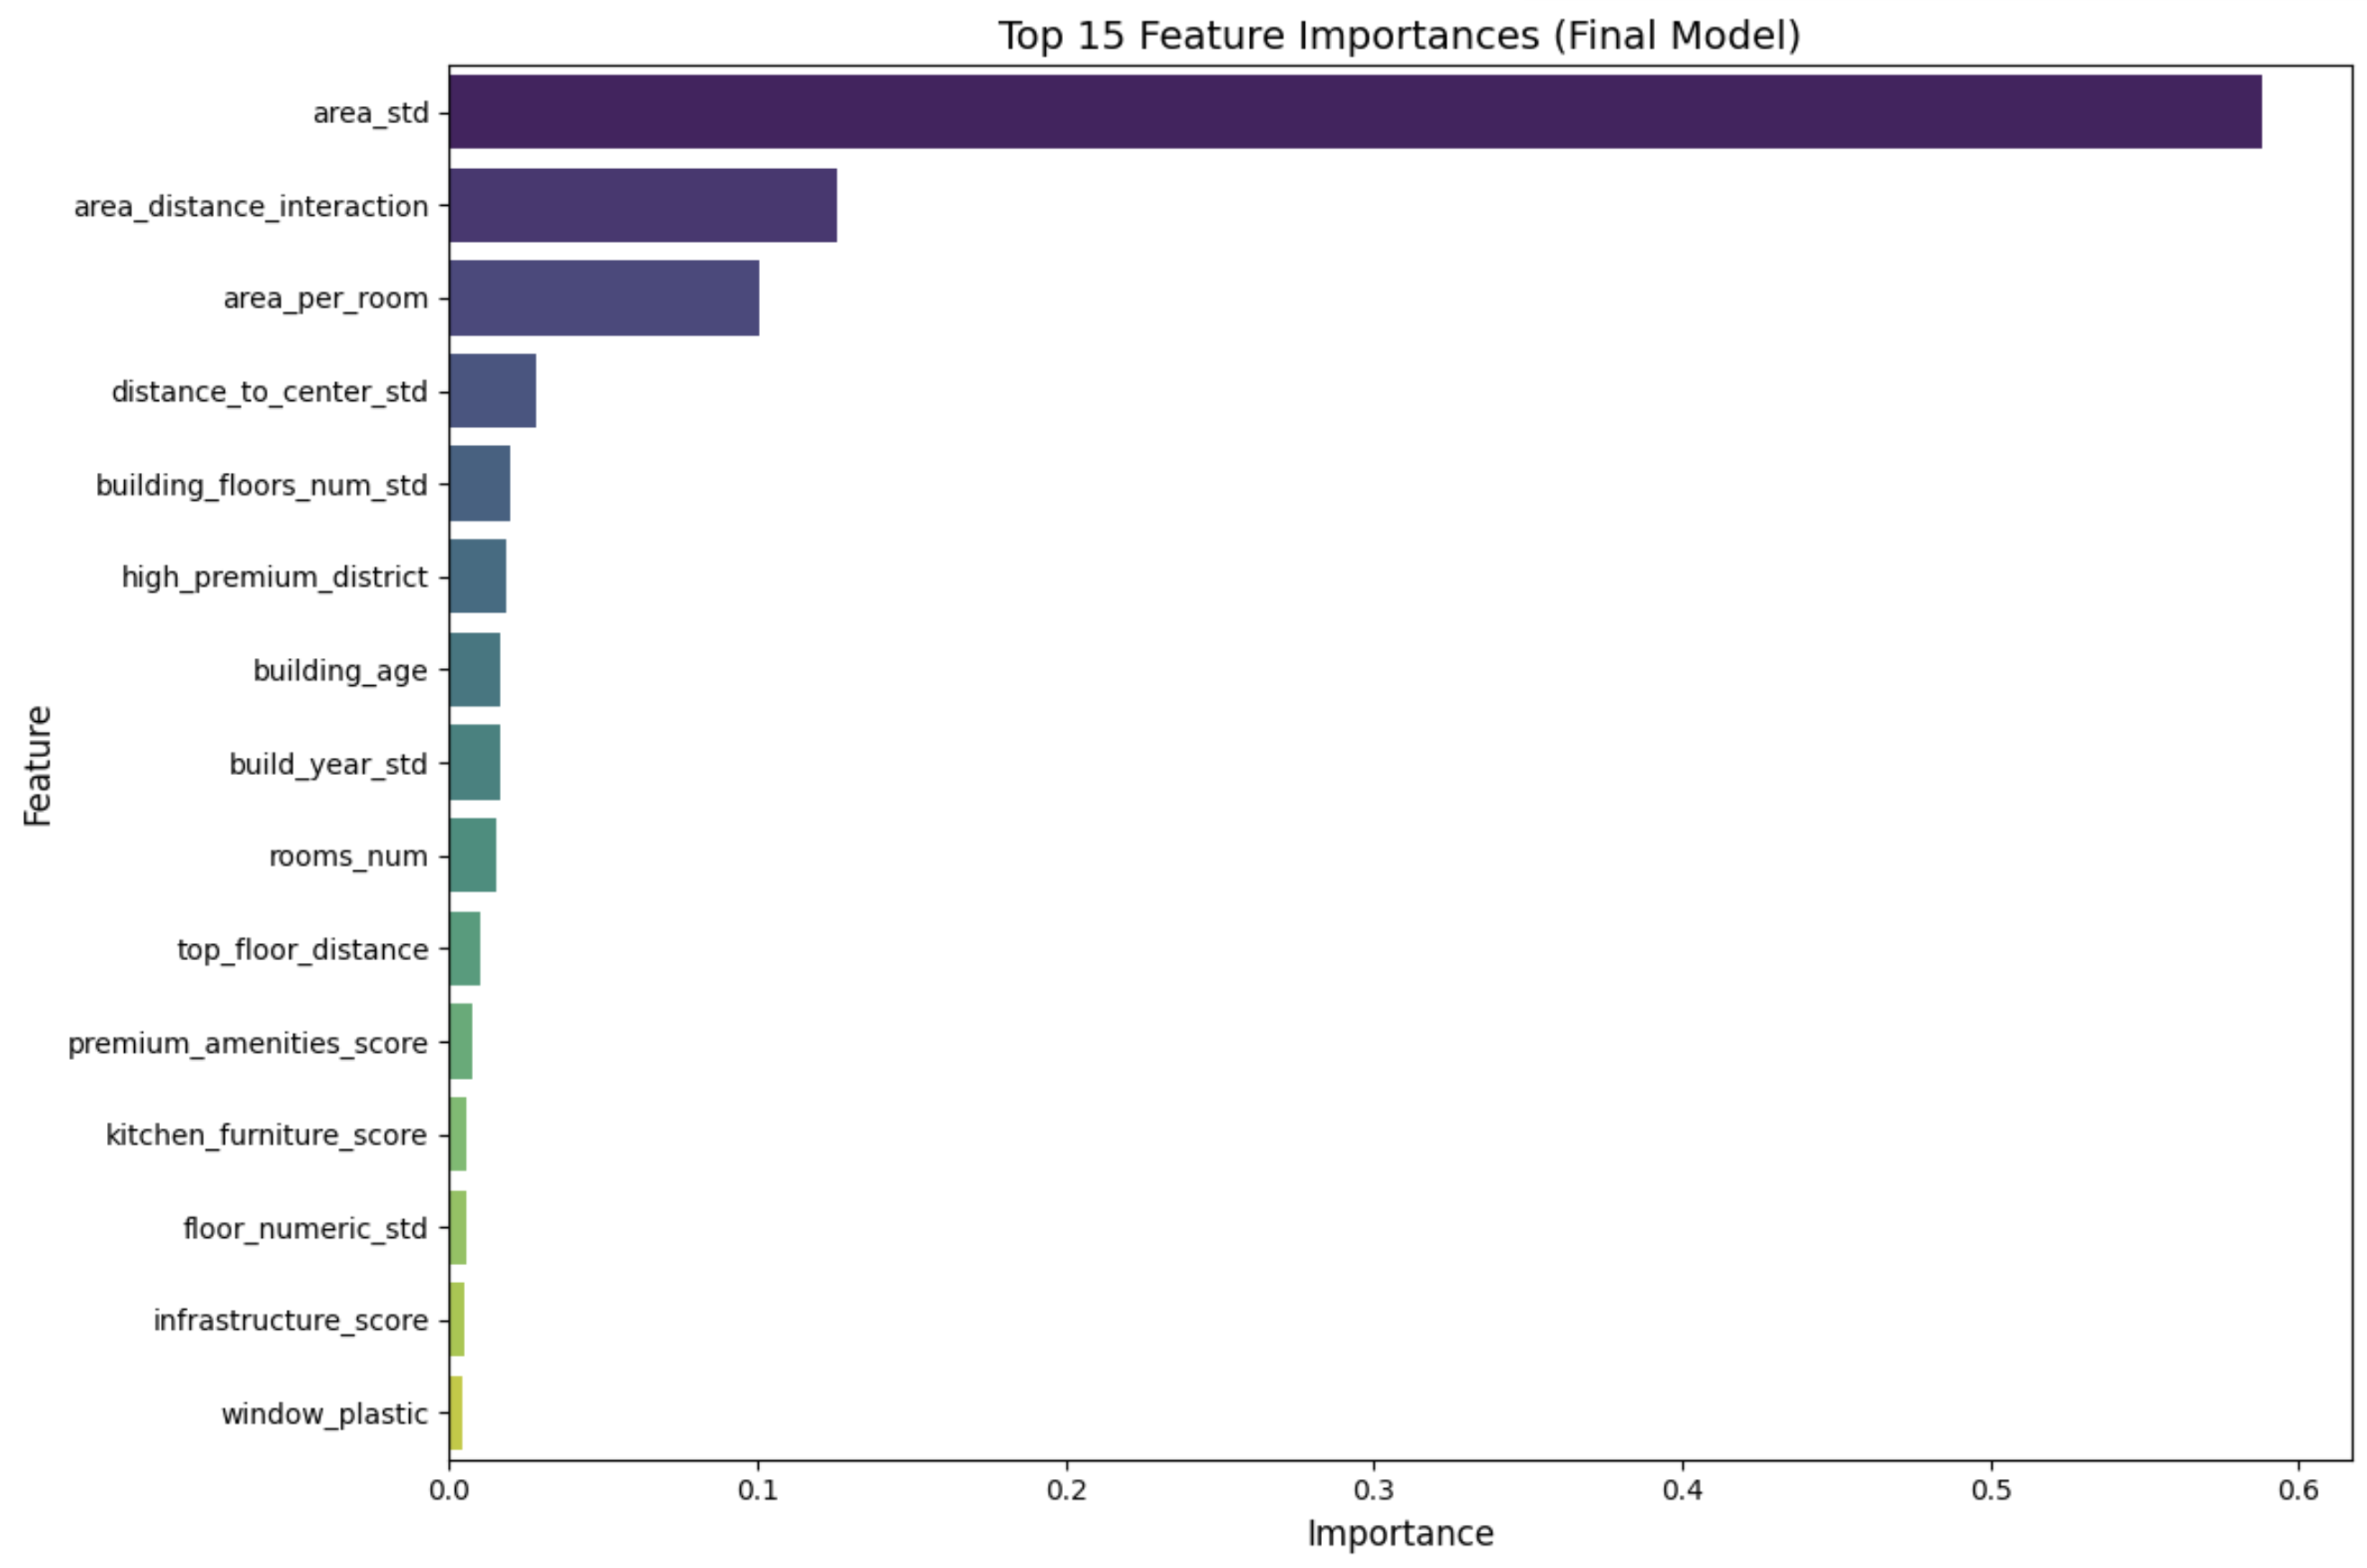

Slide 49
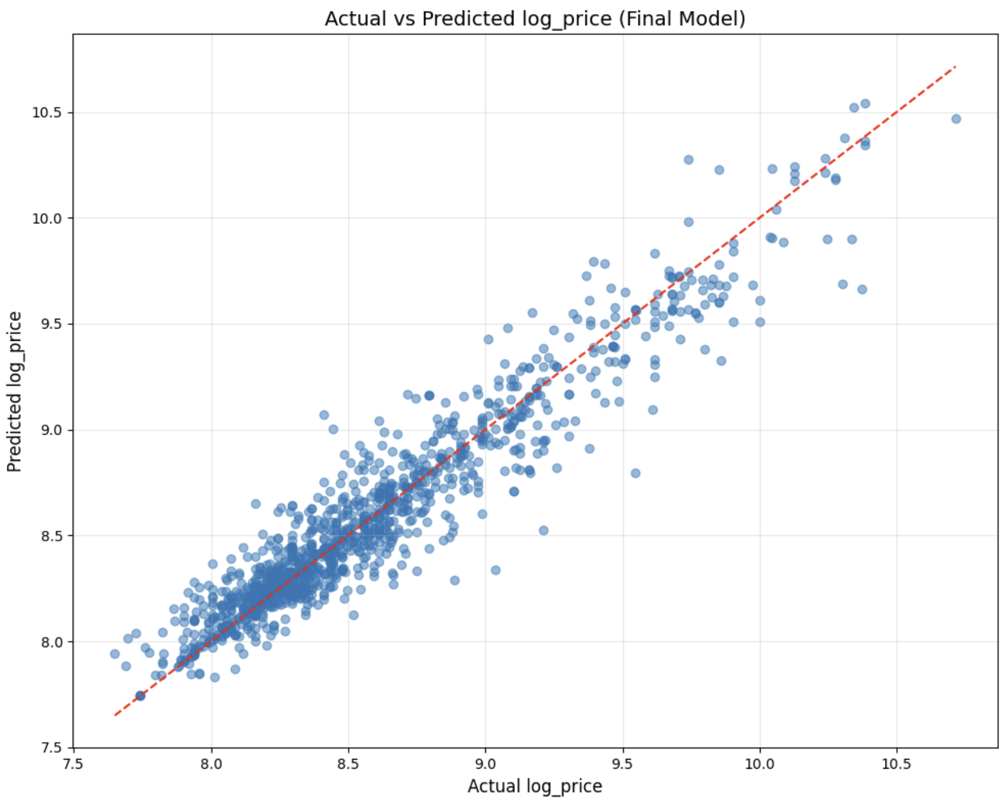

Slide 50
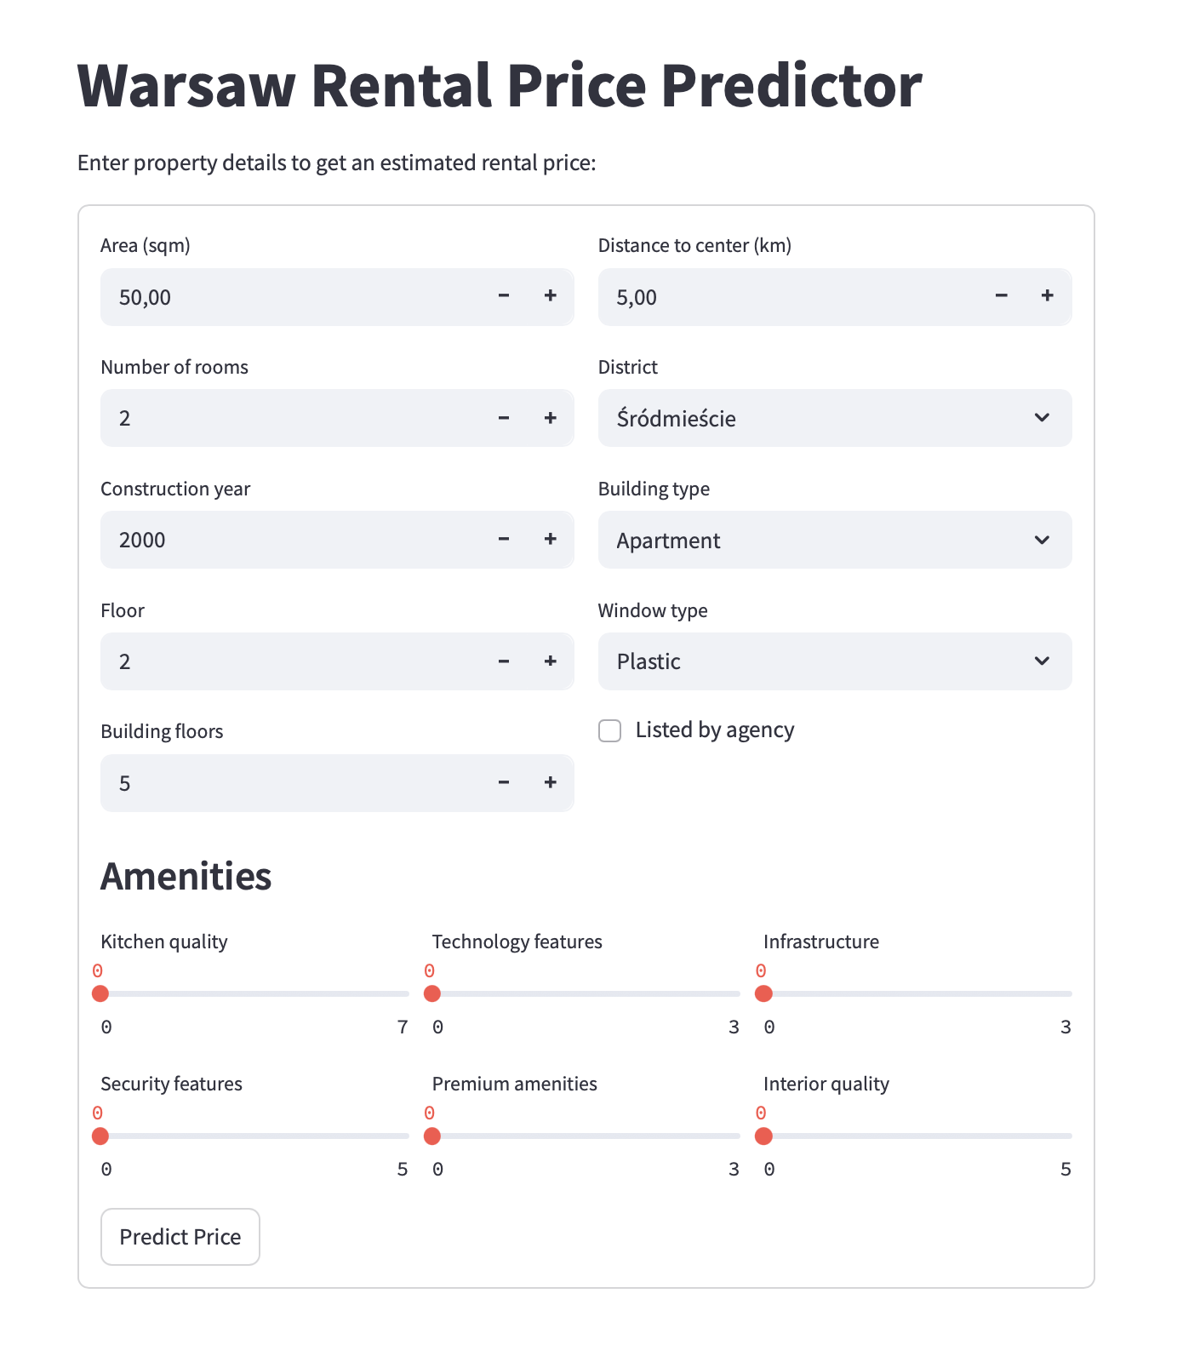
7. Deployment & Communication

